Slide 1
Data Structure and Algorithm(DSA)
TURINUMUKIZA Maurice

Slide 2
CHAPTER ONE: INTRODUCTION

Slide 3
INTRODUCTION
The procedure of solving problems using a electronic computer system requires us to transform data from one form to another. In most cases large amounts of data is to be processed. The information that is available to the computer consists of selected set of data which is considered relevant and intelligible to the problem at hand or that set in which it is believed that the desired result can be derived and presented
Data structure is a way of organizing and storing data in a computer so that it can be accessed and modified efficiently. Data structures provide a means to manage large amounts of data for various applications such as databases, web indexing services, and large-scale data processing systems.

Slide 4
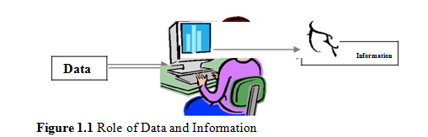
Introduction continues…

Slide 5
Importance of data structures
The data structures have the following importance for programming:
Data structures study how data are stored in a computer so that operations can be implemented efficiently
Data structures are especially important when there is a large amount of information to deal with.
Data structures are conceptual and concrete ways to organize data for efficient storage and manipulation

Slide 6
CLASSIFICATION OF DATA STRUCTURES…
Primitive data structures
Primitive data structures are the basic building blocks of data manipulation in programming. They are directly supported by the underlying hardware and typically serve as the foundation for more complex data structures. Here are the main types of primitive data structures:
Integer
Floating Point
Character
Boolean

Slide 7
Storage representation of Primitive data Structures
1.5.1.1 Storage representation of Primitive data Structures
The storage representation(Memory representation) and the possible operations (arithmetic operations, relational operations) for these types of structures are
predefined and the user cannot change this. The storage structure of these data structures may vary from one machine to another. The different primitive data structures are Boolean, integer, float, double, character, and pointer.
Boolean This is used represent logical values either true or false.
When we represent positive Integer numbers, its nothing easier as eating ice cream. Just as your can remember the memory measurement follow binary principle ie times two- times two.

Slide 8
Memory measurement
A bit is the smallest unit of data in computing and can be either a 0 or a 1. A byte consists of 8 bits
Memory sizes are typically measured in bytes, and larger units are multiples of bytes based on powers of two.
Examples:
Bytes (B):
1 Byte (B) = 8 bits
Kilobytes (KB):
1 Kilobyte (KB) = 1024 Bytes (2^10 Bytes)
Megabytes (MB):
1 Megabyte (MB) = 1024 Kilobytes (KB) = 1024 * 1024 Bytes = 1,048,576 Bytes (2^20 Bytes)
Gigabytes (GB):
1 Gigabyte (GB) = 1024 Megabytes (MB) = 1024 * 1024 Kilobytes = 1,073,741,824 Bytes
(2^30 Bytes)

Slide 9
Non-primitive data structures
Non-primitive data structures are more complex data structures that are derived from primitive data types. They are used to handle large amounts of data more efficiently and to implement various data management techniques and algorithms.

Slide 10
Classification of non-primitive data structures
Linear Data Structures
Linear data structures are types of data structures where elements are arranged sequentially or in a linear order.
Examples:
Array, Linked List, Stack, Queue, etc.

Slide 11
Classification of non-primitive data structures
Non-linear data structures
Non-linear data structures are types of data structures where data elements are not arranged sequentially or in a linear order. Instead, they are organized in a hierarchical or interconnected manner, allowing for more complex relationships between the elements.
Examples:
Trees, Graphs, etc.

Slide 12
Storage representation of non-Primitive data Structures
Non-primitive data structures, which are built upon primitive data structures, often require more memory due to additional information they store, such as pointers, references, and metadata.
Example
Arrays
Contiguous Memory Allocation: Memory is allocated for all elements in a single block.
Memory = Size of data type * Number of elements.
Example: An integer array of 10 elements requires 4 bytes * 10 = 40 bytes.
Linked Lists
Nodes with Pointers: Each node contains data and a reference to the next node.
Memory = (Size of data + Size of pointer) * Number of nodes.
Example: A singly linked list of 10 integer nodes (assuming a 4-byte pointer) requires (4 bytes + 4 bytes) * 10 = 80 bytes.

Slide 13
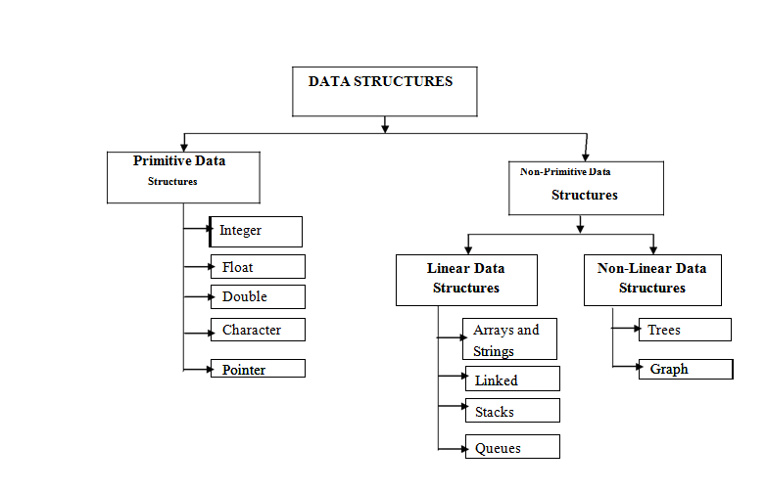
CLASSIFICATION OF DATA STRUCTURES…

Slide 14
Some of the most frequently used operations on data structures
Traversing: Accessing each record exactly once so that certain items in the record may be processed.
Searching: Finding the location of the record with a given key value or finding the locations of all records which satisfy one or more conditions
Inserting: Adding a new record to the structure.
Deleting: Removing a record from the structure.
Sorting: Arranging the records in some logical order (e.g., in numerical order according to some NUMBER key, such as social security number or account number).
Merging: Combining the records of two different sorted lists into a single sorted list.

Slide 15
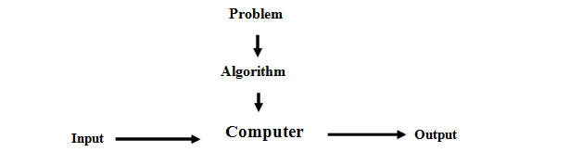
ALGORITHM:
ALGORITHM: A set of ordered steps or procedures necessary to solve a problem. But general agreement about what the concept means, An algorithm is a sequence of unambiguous instructions for solving a problem, i.e., for obtaining a required output for any legitimate input in a finite amount of time.

Slide 16
Characteristics of good algorithm
A good algorithm is one that performs efficiently and effectively for the problem it is intended to solve. Here are the key characteristics that define a good algorithm:
Correctness
The algorithm should correctly solve the problem for all possible inputs.
Example: If an algorithm is designed to sort an array, it should always return the array in sorted order regardless of the initial arrangement of elements.

Slide 17
Characteristics of good algorithm…
2. Efficiency
Time Complexity: The amount of time an algorithm takes to complete as a function of the length of the input.
Example: An algorithm with O(n log n) time complexity is generally more efficient than one with O(n²) for large inputs.
Space Complexity: The amount of memory an algorithm uses in relation to the input size.
Example: An in-place sorting algorithm that uses O(1) additional space is usually preferable to one that requires O(n) additional space.
3. Finiteness
The algorithm must terminate after a finite number of steps.
Example: An algorithm that enters an infinite loop is not a good algorithm.
4. Clarity and Simplicity
The algorithm should be easy to understand and implement.
Example: Clear variable names, well-defined steps, and comments can make an algorithm easier to follow and debug.
5. Generality
The algorithm should be applicable to a broad range of problems.
Example: A sorting algorithm like quicksort can be used to sort numbers, strings, and other sortable items.

Slide 18
Characteristics of good algorithm…
6. Robustness
The algorithm should be able to handle unexpected or unusual inputs gracefully.
Example: An algorithm should not crash or produce incorrect results if given an empty input or input with special characters.
7. Maintainability
The algorithm should be easy to modify and extend.
Example: Well-structured and modular algorithms are easier to update when requirements change.

Slide 19
End

